Slide 1
Temperature Simulation & Infrared Modulation
Dev Bhatia
Ultrafast Optics Laboratory
Boston University

Slide 2
Introduction
This research project is focused on exploring and characterizing optical pathways for external neurostimulation
Novel optical systems are being investigated to stimulate nerves and conduct electrophysiology measurement
There is an emphasis on understanding the underlying mechanisms of infrared nerve stimulation & inhibition
Important applications in the medical world; sensory dampening

Slide 3
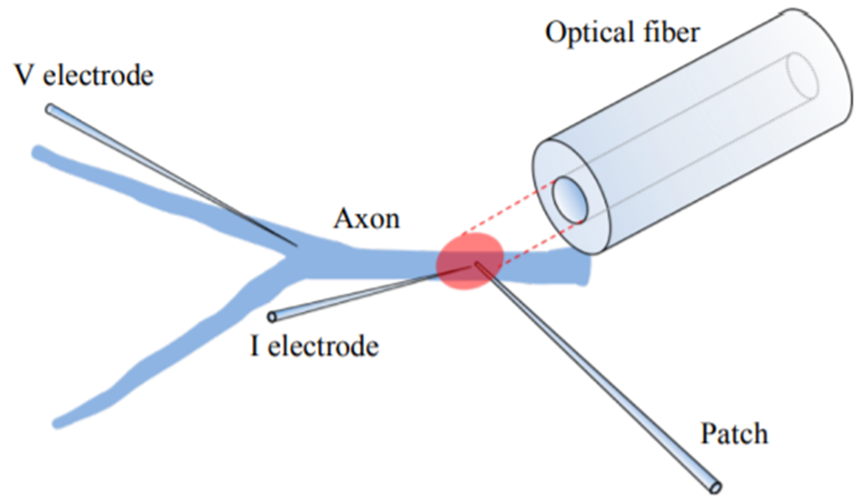
Experimental Configuration
A crayfish axon is glued to the bottom of a petri dish
Axonal activities are studied using 2000 nm light pulses
The current injector and location of measurement can be adjusted to induce different states
Experimental Design [5]

Slide 4
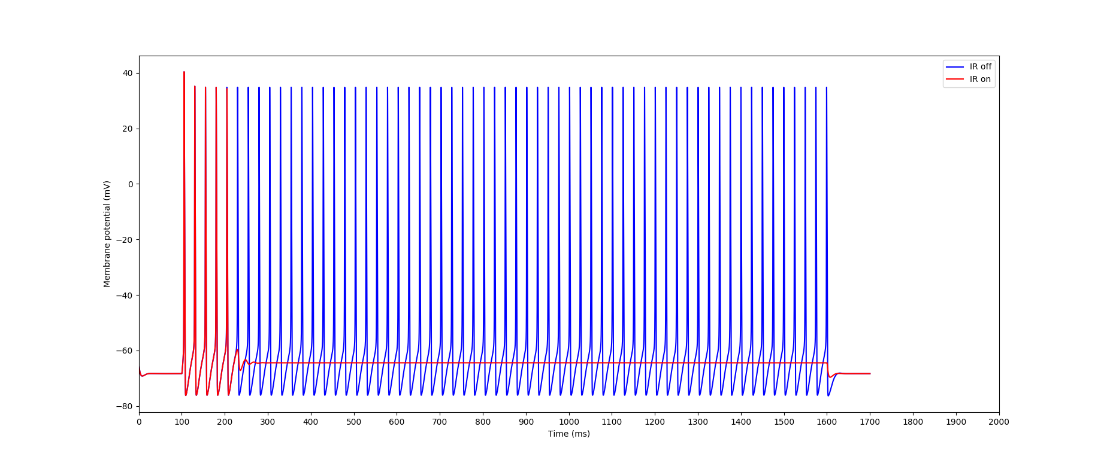
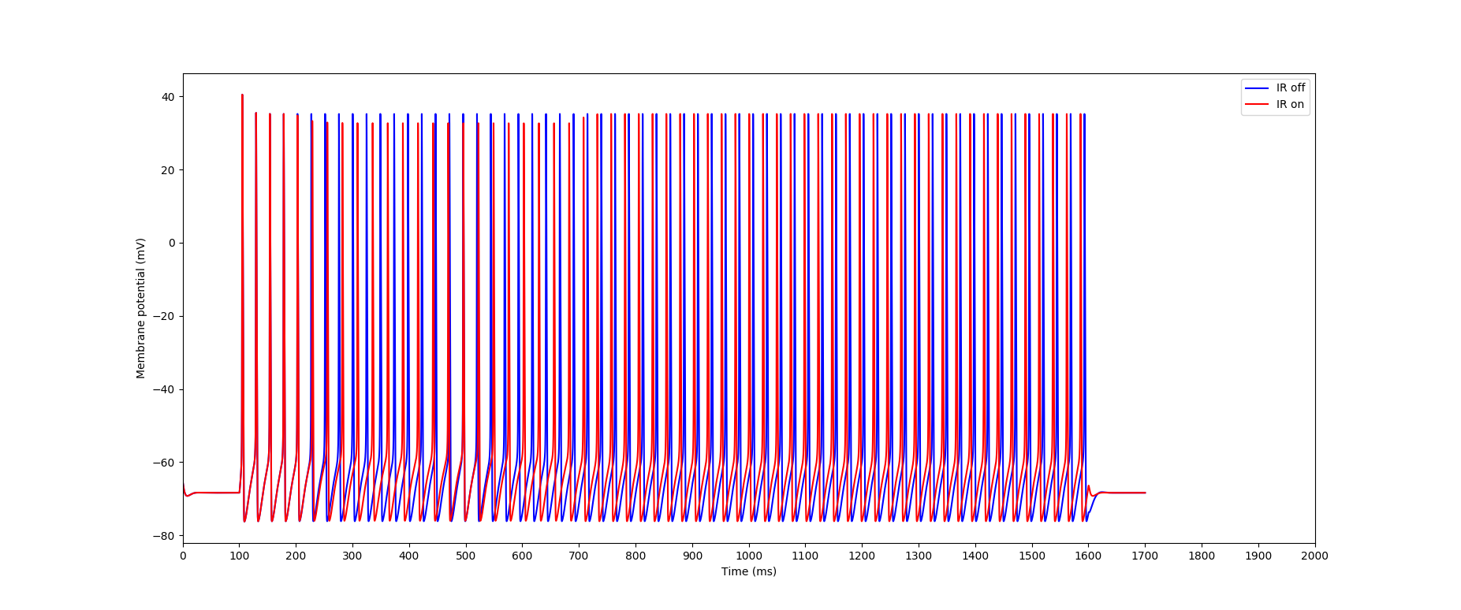
Action Potential Blocking

Slide 5
NEURON Programming Environment
NEURON is a widely used programming environment for modeling both individual neurons and networks of neurons
Developed by researchers at Yale University
Allows for the construction of biologically realistic membranes with both active and passive ion channels
Built-functions for current injection and voltage measurement

Slide 6
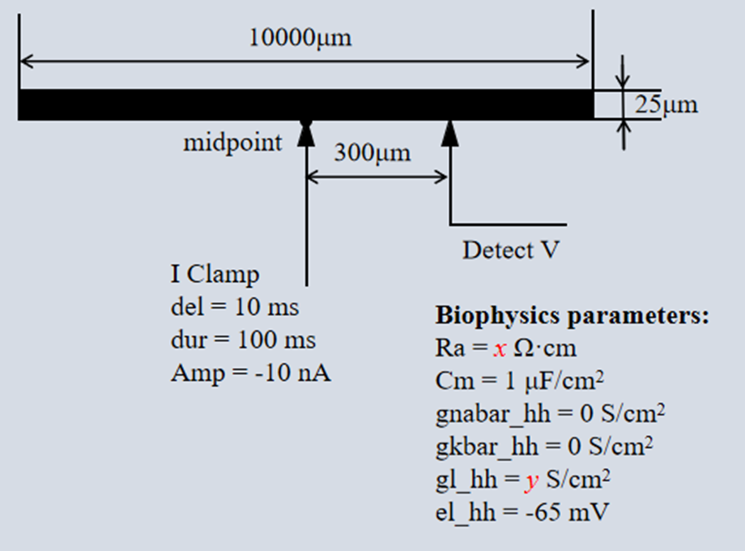
Previous Work
A model to measure potentials of the axon has been developed by a previous student
Simulates experimental membrane potentials and phase plots
Fails to account for increases in temperature and correlating effects on ion channel kinetics
Axon Modeling Diagram [5]

Slide 7
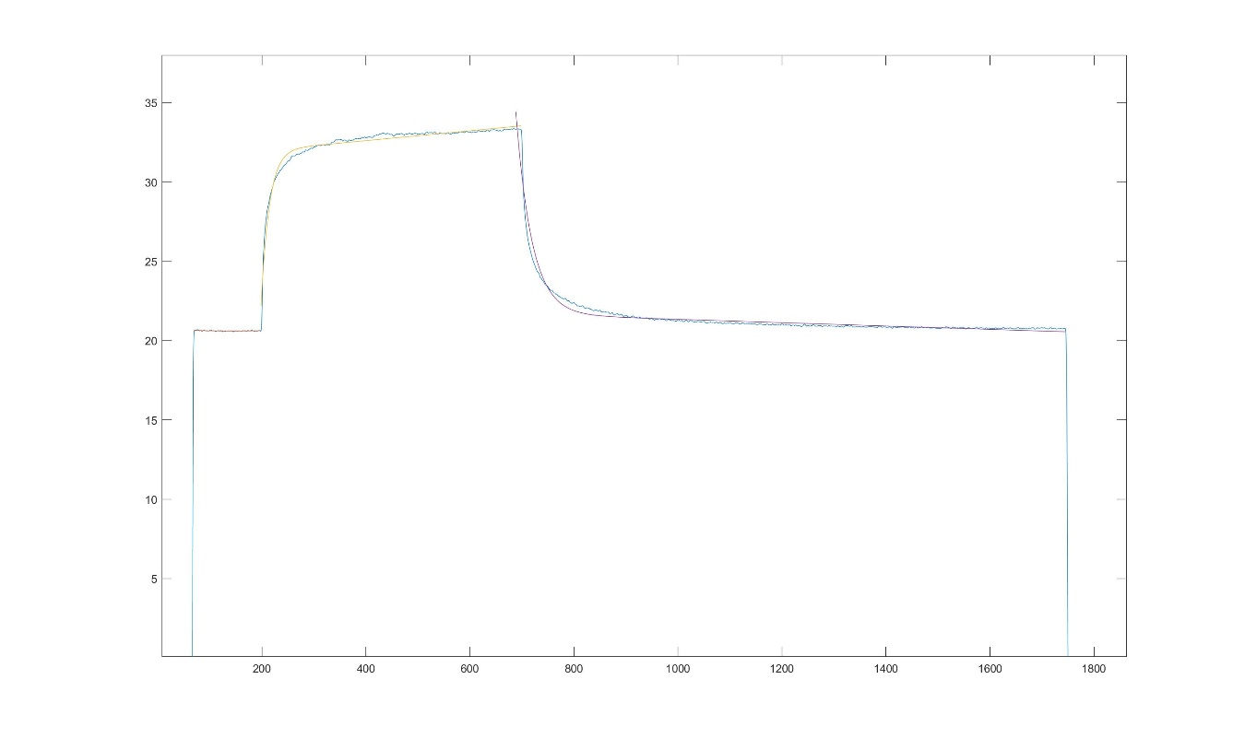

Temperature Fitting
$$T=ae^{bt}+cⅇ^{dt}$$
Complete Temperature Depiction using Matlab

Slide 8
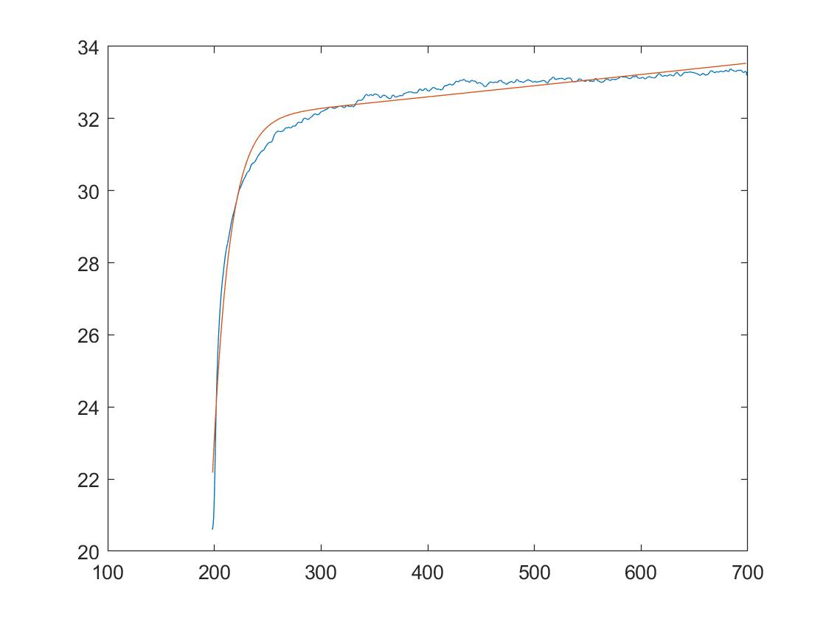
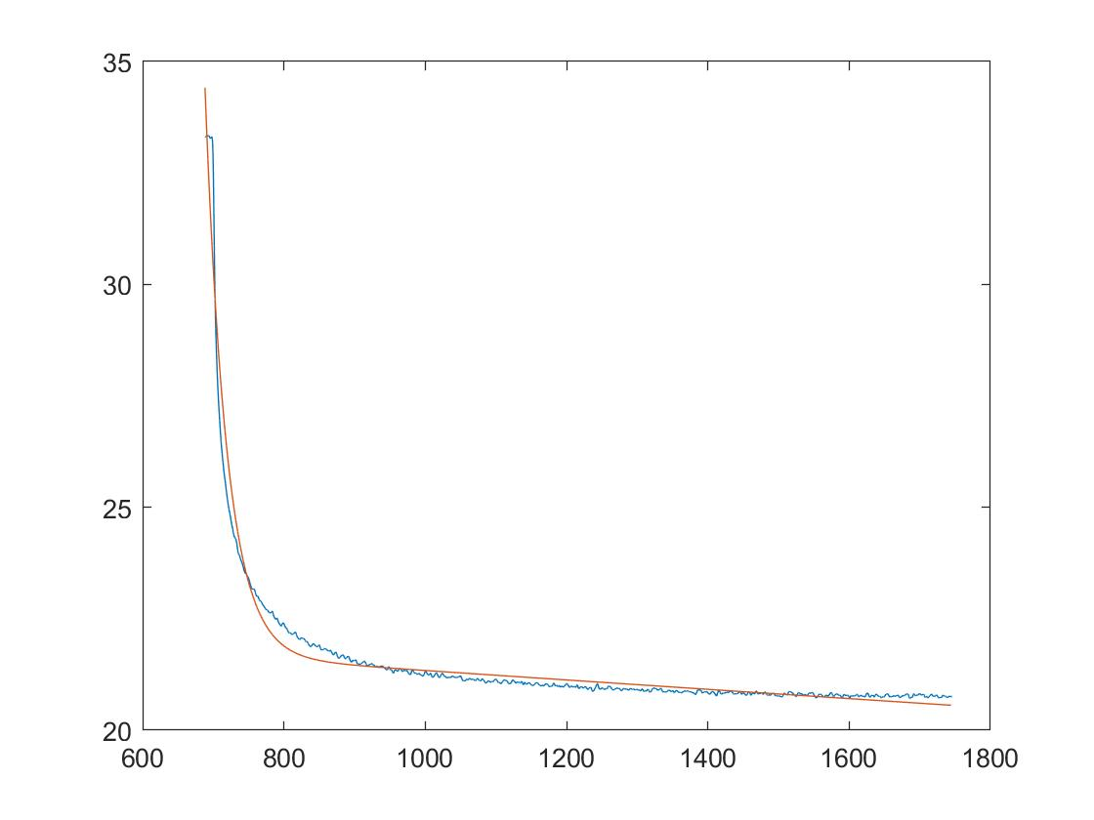
Temperature Fitting
General Model:
f(x) = a*exp(b*x) + c*exp(d*x)
200ns < t < 700ns
700 ns < t < 1700 ns
IR on Temp. Increase
IR off Temp. Decrease

Slide 9
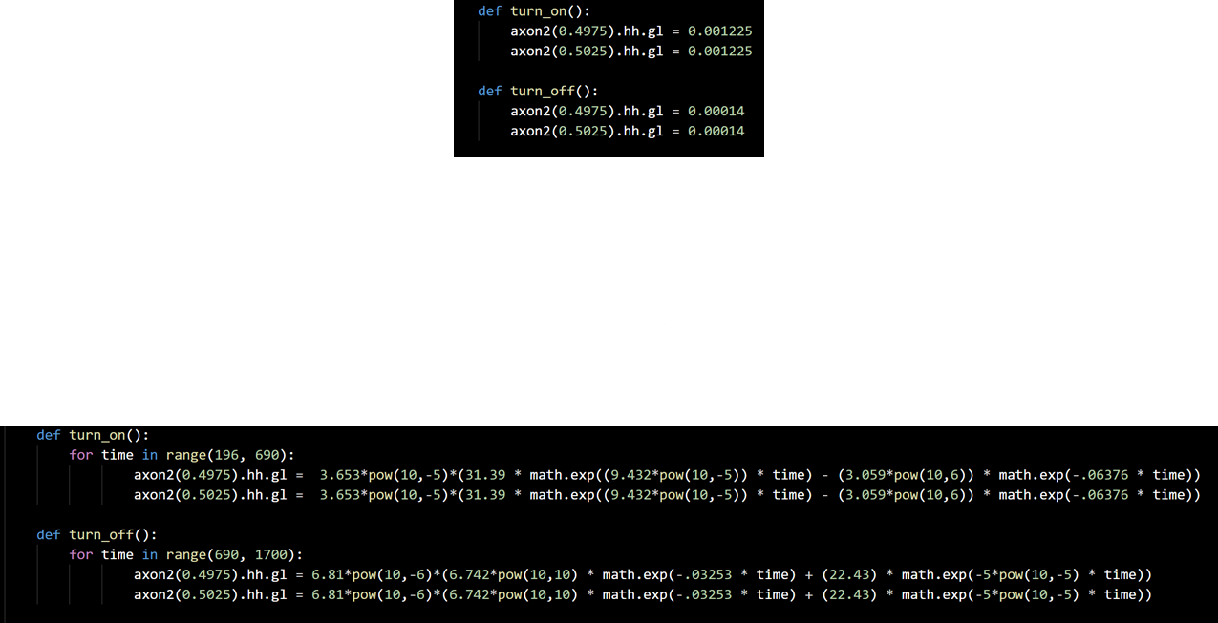
Conductance Implementation
By correctly scaling the acquired temperature equations, we were able to successfully depict the rise and fall of the leak conductance

Slide 10
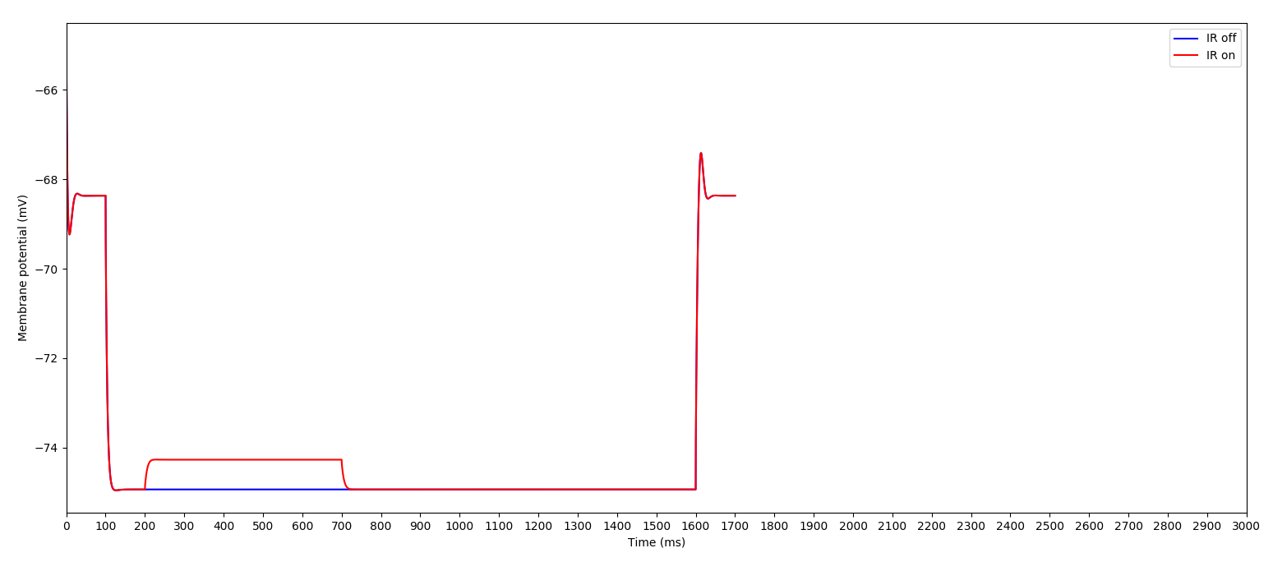
Leak Conductance

Slide 11
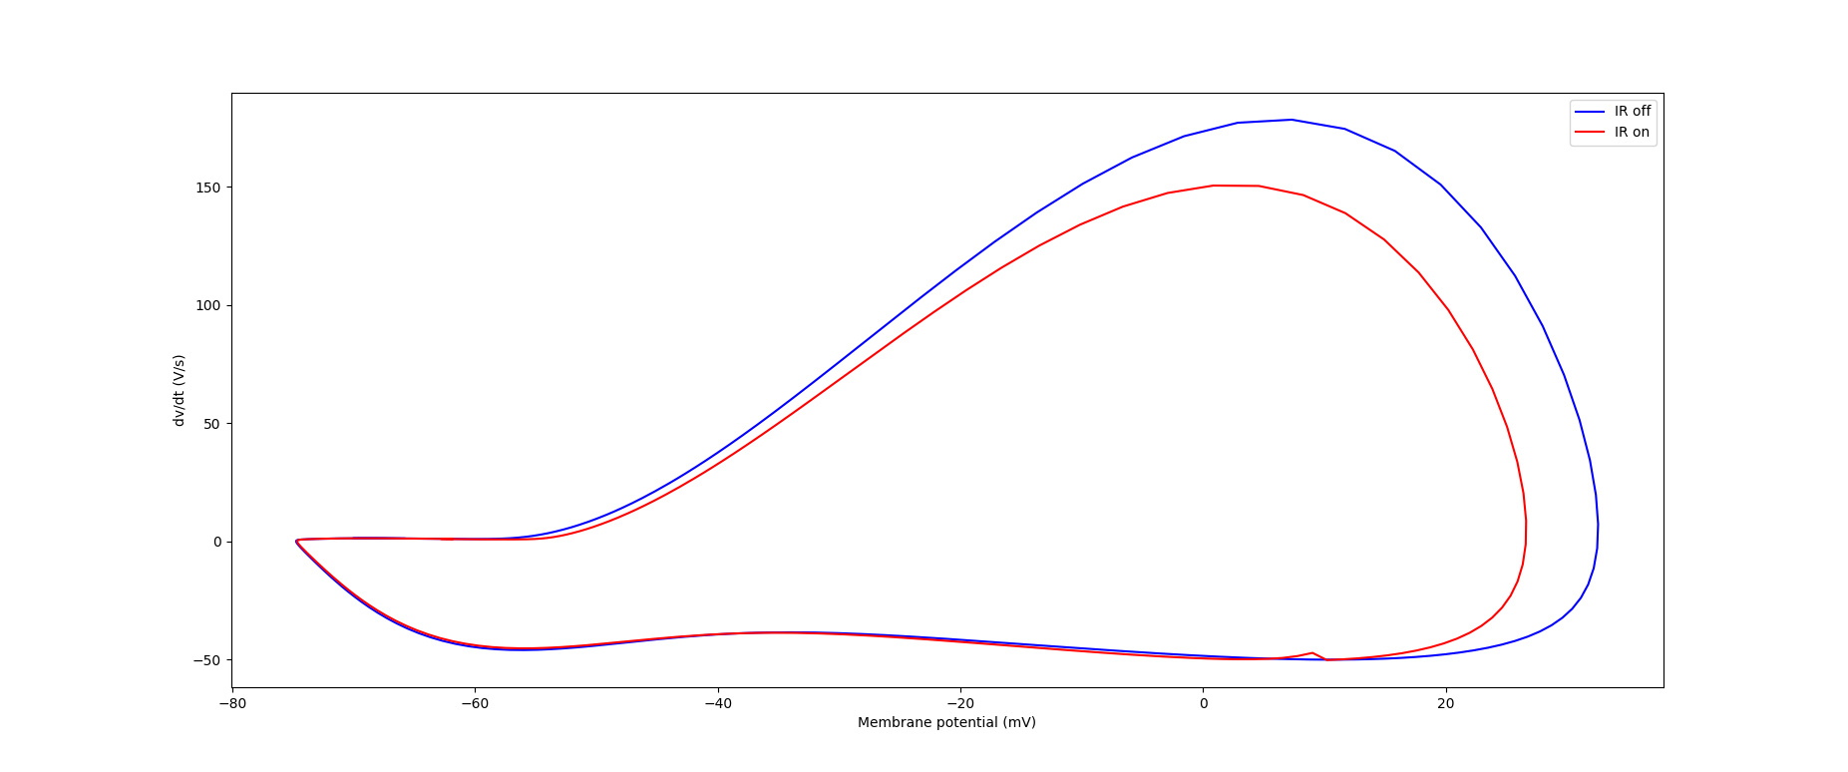
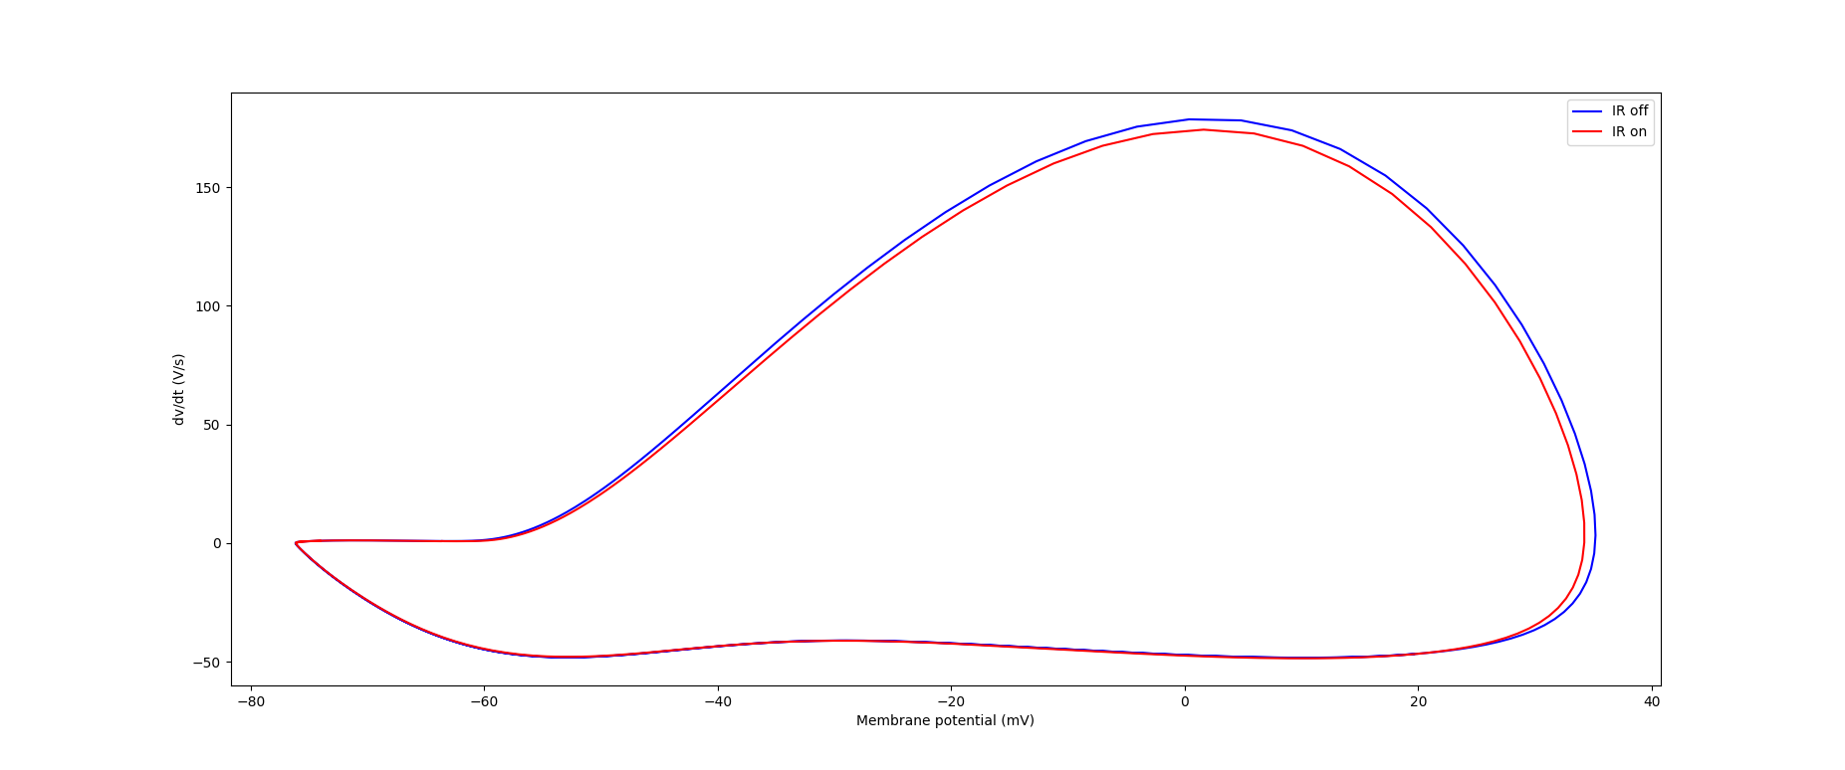
APII & APPB
Action Potential Initiation Inhibition –
Current injected halfway
Voltage measured close downstream
Action Potential Propagation Block –
Current injected at the start
Voltage measured far away

Slide 12
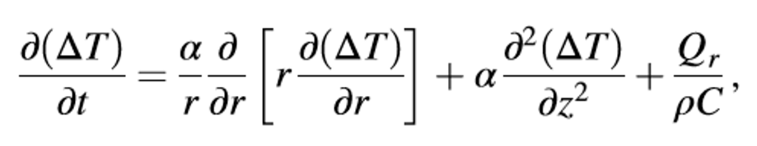
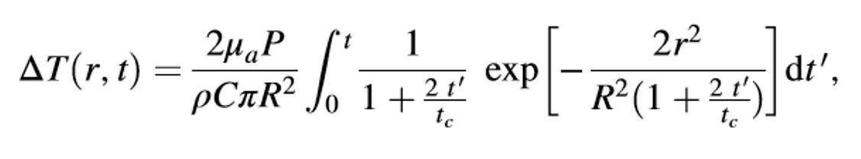
Temperature Script
Mathematical Model of Heat Conduction Equation [3]
Equation 1 solved using a Gaussian approximation. ΔT obtained in consideration of the thermal lens effect [3]
The thermal lens effect occurs when the laser beam is absorbed in the focusing region
Equation 2 predicted a linear relationship between the laser power and ΔT.
This deduction was confirmed via an open pipette method to measure the ΔT directly
980-nm wavelength infrared laser irradiation

Slide 13
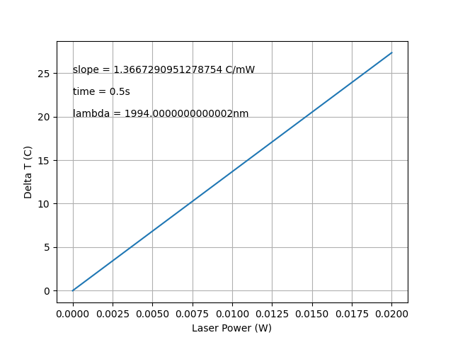
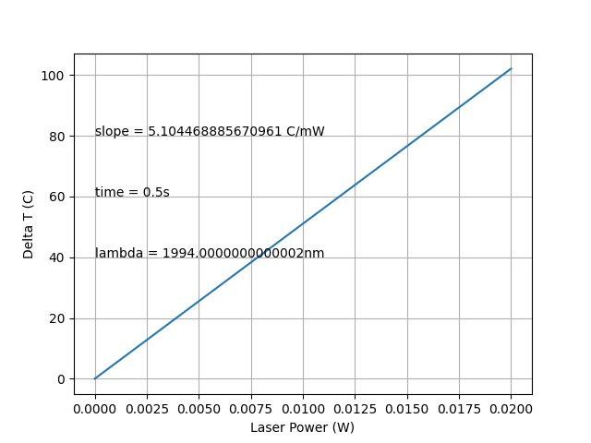
Temperature Script Output
Radius of beam waist at axial distance = 50 microns
Radius of beam waist at axial distance = 25 microns

Slide 14
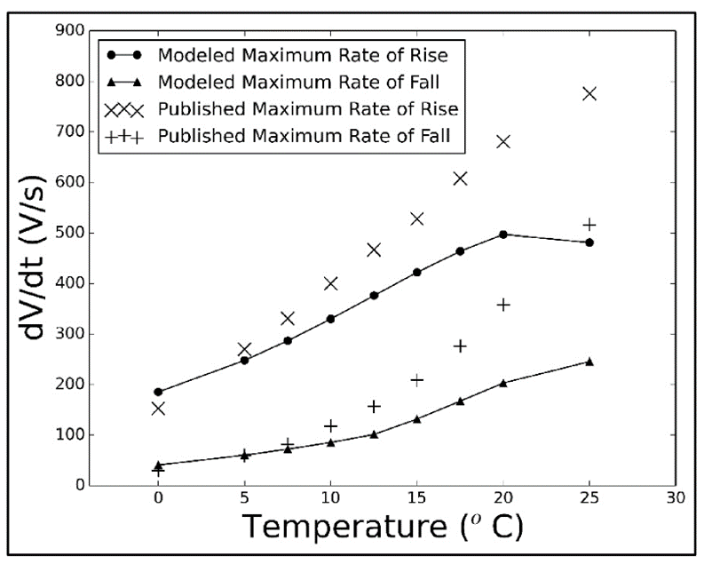
Vanderbilt Software
A laboratory at Vanderbilt University has developed a NEURON model for a giant squid axon
The overall geometry and biophysical parameters are vastly different
Investigating their codebase may lead to implementation strategies for the crayfish axon
Model Validation [4]

Slide 15
References
[1] Zhu, Xuedong, Jen-Wei Lin, and Michelle Y Sander. "Infrared Inhibition and Waveform Modulation of Action Potentials in the Crayfish Motor Axon." Biomedical Optics Express 10, no. 12 (2019): 6580-6594.
[2] Yao, Jing, Beiying Liu, and Feng Qin. "Rapid Temperature Jump by Infrared Diode Laser Irradiation for Patch-Clamp Studies." Biophysical Journal 96, no. 9 (2009): 3611-619.
[3] Li, Xinyu, Jia Liu, Shanshan Liang, and Changsen Sun. "980-nm Infrared Laser Modulation of Sodium Channel Kinetics in a Neuron Cell Linearly Mediated by Photothermal Effect." Journal of Biomedical Optics 19, no. 10 (2014): 105002-105002.

Slide 16
References cont.
[4] Ganguly, M., Jenkins, M. W., Chiel, H. J., &amp; Jansen, E. D. (2016). Modeling the effects of elevated temperatures on action potential propagation in unmyelinated axons. Clinical and Translational Neurophotonics; Neural Imaging and Sensing; and Optogenetics and Optical Manipulation. doi:10.1117/12.2211048
[5] Fu, Jia. Simulation Study of the Infrared Nerve Inhibition. August 2019. Powerpoint Presentation

